Slide 1

PARTNERSHIP GUIDE · 2026
Journey Up!
Impact & Partnership Guide
A movement for healing, belonging & authentic living.
PRESENTED BY
NAJE BADU LOVE
Notes:
Open warm. This is an invitation to join a movement, not a pitch.

Slide 2
WHY JOURNEY UP EXISTS
Heal your story. Break the cycle. Rise into your highest self.
Journey Up! was founded by Naje Badu Love as a healing practice turned movement — helping women rewrite their stories, heal generational cycles, and step into their purpose.
GROW · HEAL · TRANSFORM
It heals.
It ripples.
Together, we rise.
The work begins within — real, lasting personal healing.
Into families, communities, and the future.
Together, we transform.
HEALING BEGINS WHEN PEOPLE FEEL SEEN, HEARD, ACCEPTED & EMPOWERED
Notes:
Healing begins within, then ripples outward. State the founding purpose plainly.

Slide 3


JOURNEY UP AT A GLANCE
One Movement, Many Doorways
01
02
Books
Publishing
One ecosystem that meets people wherever healing begins.
04
Courses
The Movement
Every doorway leads here.
Notes:
One ecosystem, many entry points. Every doorway leads to the same movement.

Slide 4

MEET THE FOUNDER
Naje Badu Love
Author · Coach · Speaker · Community Builder · Former NCAA Official · Entrepreneur
✦
20+ years in personal development & wellness
✦
An authentic, relatable approach that resonates with audiences worldwide
✦
Based in Dallas · Atlanta · Los Angeles
Notes:
Naje's depth: two decades, structured systems thinking plus deep emotional intelligence.

Slide 5
THE FOUNDER'S JOURNEY
A Different Way of Seeing
Autism · Introversion · Healing · Self-Discovery · Authentic Leadership
✦
Autistic — and it is central to how she leads.
✦
Introverted by nature, fluent in deep, one-to-one connection.
✦
Her autism shapes a pattern-level empathy — sensing what others feel but cannot yet name.
✦
Her introversion creates calm, unhurried rooms where people feel safe enough to be honest.
✦
Her own healing and self-discovery became the blueprint for the work she now guides others through.
“I create the spaces I once needed.”
Notes:
Her autism and introversion are central to how she leads — pattern-level empathy, calm rooms.

Slide 6
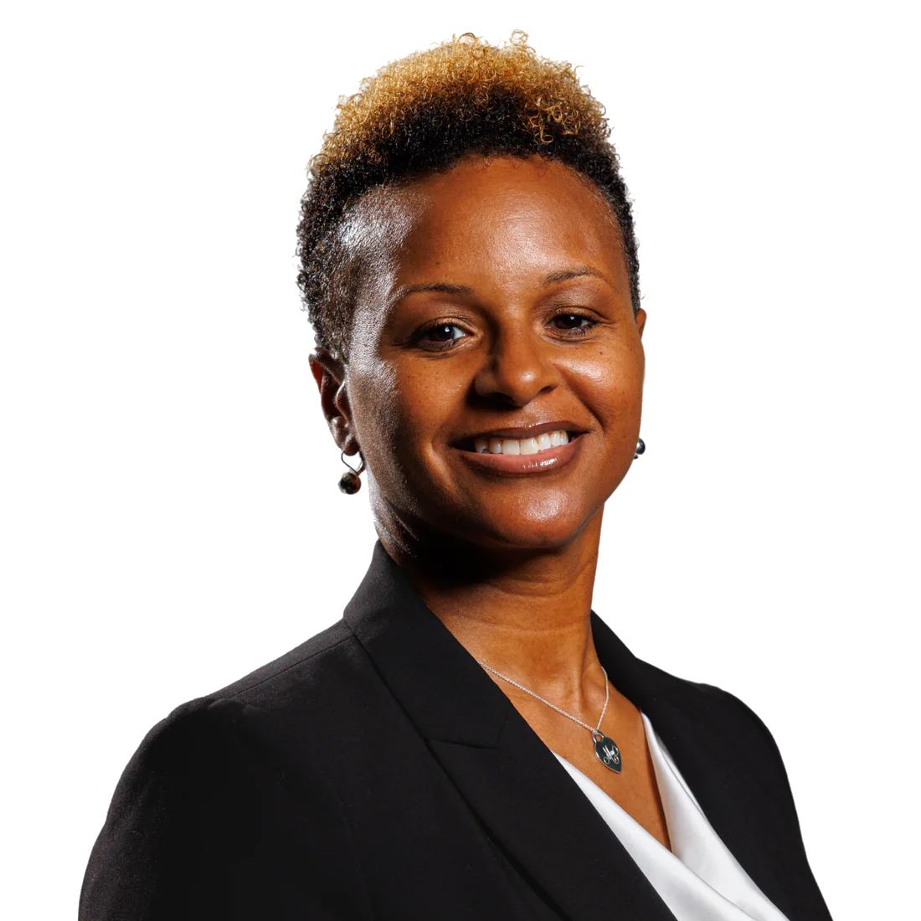
MEET THE LEADERSHIP
Nicole VanZandt
Chief Marketing Officer · Partnerships · Community · Brand Growth
✦
The strategic force translating the mission into movement & reach
✦
Builds the strategic partnerships that carry Journey Up into new communities
✦
Where vision meets reach — growing the movement, community first
✦
Leads brand growth and storytelling — shaping how the world first meets the movement
Notes:
Nicole turns the mission into movement and reach — the strategic force behind growth.

Slide 7
THE JOURNEY UP STORY
From personal healing to collective transformation.
It began as one woman's decision to stop performing and start healing — private work that became a shared language — and then a movement that thousands now call home.
Every breakthrough becomes someone else's beginning.
01
02
03
The wound.
The work.
The movement.
The patterns we inherit — and the moment we choose to face them.
Honest healing that reshapes how we live, love, and lead.
Healing that ripples into families, communities & generations.
HEALING · IDENTITY · AUTHENTICITY · BELONGING · PURPOSE · COMMUNITY
Notes:
From private healing to a shared language to a movement thousands call home.

Slide 8
THE JOURNEY UP! APP
Your Personalized Growth Journey
13 self-guided learning paths
01
02
03
04
05
06
Self-Love
Awareness
Gratitude
Vision
Purpose
Freedom
07
08
09
10
Joy & Bliss
Power & Potential
Health & Wellness
Mindset
Notes:
The app turns the framework into a personalized, self-guided journey of 13 paths.

Slide 9

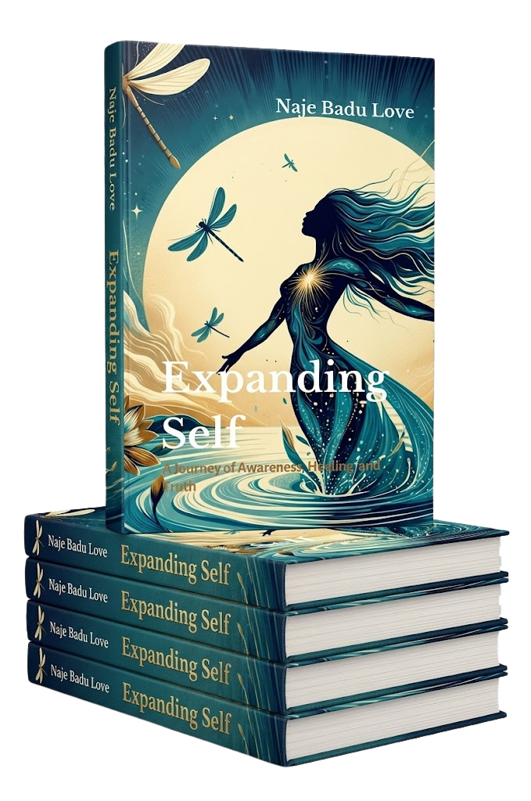
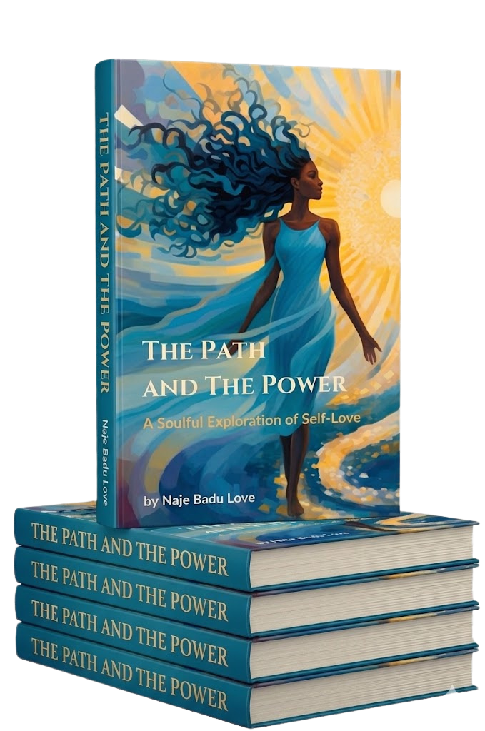
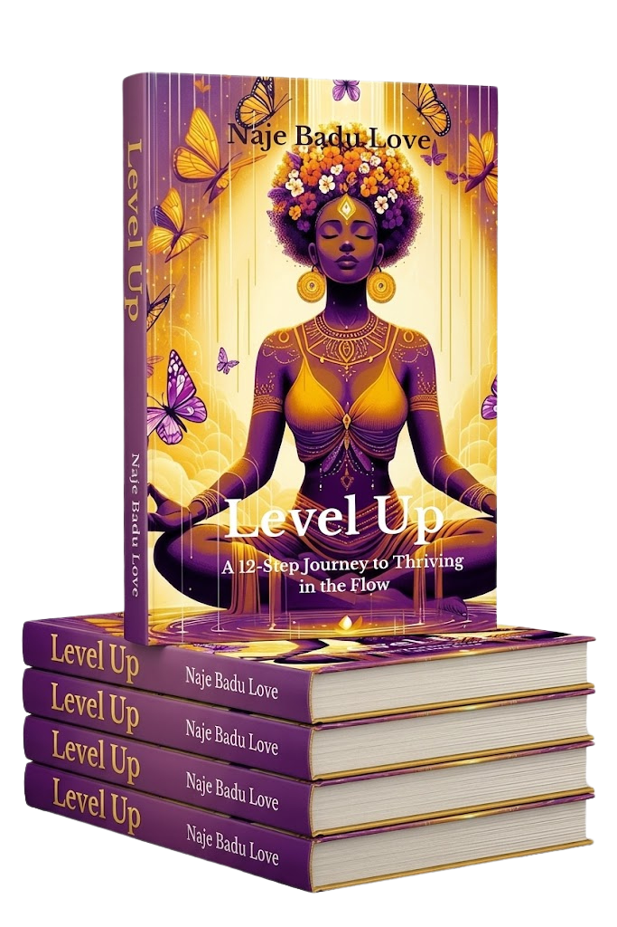
THE LIBRARY
Signature Books
Written by Naje Badu Love · Published by Journey Up! Publishing
The Path and The Power
Expanding Self
Let Go of Your But!
Level Up!
A Soulful Exploration of Self-Love
Consciousness & personal evolution
A Woman's Guide to Self-Love & Fulfillment
A 12-Step Journey to Thriving in the Flow
Notes:
Five signature books, each a doorway. All written by Naje, published by Journey Up!

Slide 10

THE JOURNEY UP! JOURNAL COLLECTION
Self-Guided Journey Journals
12 beautifully designed journals aligned with the 12 Journey Up! Paths — covering self-love, awareness, gratitude, vision, purpose & more.
The perfect companions for anyone ready to elevate their life's journey.
The Path
Each journal maps directly to one of the 12 core Journey Up! paths.
The Book
Every journal is intentionally paired with a specific companion book.
The Course
Each book powers a dedicated, interactive course on the Journey Up! App.
Notes:
Twelve journals map to the twelve paths — each pairs with a book and powers a course.

Slide 11
Helping People Feel Seen
Healing begins the moment a person feels seen, heard, accepted & empowered. Everything we build starts here.
Notes:
Slow down here. This is the emotional core of everything we build.

Slide 12
THE SIGNATURE EXPERIENCE
Journey Up Live: Coffee, Conversations & Community
WHERE WE GATHER
Atlanta
Dallas
✦
Intimate gatherings over coffee where real conversation begins
✦
Honest dialogue on healing, belonging & authentic living
Houston
Washington DC
✦
A judgment-free space where every person feels seen
✦
Founder-led storytelling that turns strangers into community
Chicago
Los Angeles
✦
Live reflection, journaling & guided conversation
✦
Connection that continues long after the room clears
Notes:
The signature in-person experience — intimate, founder-led, judgment-free rooms.

Slide 13

FEATURED INITIATIVE
Finally Yours (The eBook)
For Women Who Are Ready
A speaking initiative and intensive program for cycle breakers — women who have been shaped to be everything for everyone, and are now ready to reclaim their own lives.
THE 5 SIGNS YOU'VE BEEN LIVING SOMEONE ELSE'S LIFE
01
You know what everyone needs — but not what you want
Notes:
The featured initiative for cycle breakers. Read the five signs slowly — they land.

Slide 14
SPEAKING & PODCASTS
Invite Naje to Inspire Your Audience
✦
Journaling into Greatness
✦
Breaking Free from Self-Doubt & Betrayal
✦
Who You've Been Is Not Who You ARE
✦
Success Keys: Living in Authenticity and Alignment
✦
Releasing Old Identities that No Longer Serve
✦
Emotional Intelligence & Healthy Relationships
Notes:
A deep, flexible catalog of talks. Tailor the topic to the room.

Slide 15
A GROWING COMMUNITY
Reach & Resonance
Substack Newsletter 100+ daily views · 900+ monthly views
1.0K+
1.2K+
481+
376+
FACEBOOK
YOUTUBE
COMMUNITY
INSTAGRAM
“
Naje walked into our women's leadership event and said the thing every woman in that room had been feeling but could not find words for. She did not just inspire us — she named something real. Our team is still talking about it weeks later.
Kelly Erin
Executive Leader · Assurant Inc.
Notes:
The reach is real and the resonance is deeper. Let the testimonials speak.

Slide 16
LET'S BUILD TOGETHER
Ways to Partner
01
02
03
04
Guest Expert
Co-Branded Products
Podcast Features
Event Partnerships
Featured on the Journey Up! platform
Guest appearances or host swaps
Retreats, masterminds & live trainings
Journals, workshops & digital tools
WHY PARTNER
$1 Trillion+ wellness market · Trending topics · Proven tools
Notes:
Four concrete on-ramps. The wellness market is a trillion-dollar opportunity.

Slide 17
WHO THIS IS FOR
The Right Rooms for This Message
PRIORITY TOUR MARKETS
Atlanta
✦
Divine Nine Sorority Chapters & Regional Conferences
Dallas
✦
Women's College Campuses, including HBCUs
Houston
Washington DC
✦
Fortune 100 & 500 Corporate Women's Leadership & ERG Programs
Chicago
✦
Women's Personal Development & Healing Podcasts
Los Angeles
✦
Women's Conferences & Summits
✦
NCAA Athletic Programs & Women in Sports Organizations
Notes:
Where this message belongs — and the markets we're prioritizing for the tour.

Slide 18
AN INVITATION TO JOIN
Start the Conversation
EMAIL
WEB
info@journey-up.com
journey-up.com
“You have been showing up for everyone. This is where you finally show up for yourself.”
SOCIAL
PHONE
@JourneyUpInspiration
999.408.5769
Book Naje to Speak
→
Partnerships — Nicole VanZandt, Chief Marketing Officer · partners@journey-up.com
Notes:
Make the ask warm and human. Hand off to partnerships for next steps.

Slide 19
Together, We Rise.
Every person deserves to be seen. Every story deserves to be heard. Every journey deserves hope. Together, we Journey Up.
Notes:
Close on the mission. Leave the room with the invitation, not the brochure.

